Slide 1
Machine Learning 101

Slide 2
Notes:
The McGill initiative on Computational Medicine was formed in 2017 and aims to deliver inter-disciplinary research programs and empower the use of data in health research and health care delivery
Located at the Genome Center
They have a newsletter were you can subscribe to
more info on the web site

Slide 4
Workshop agenda
Intro to Machine Learning (ML)
ML models
Applications and challenge
Code implementation
Coding session – group activity
Q&A

Slide 5

Terminologies
Artificial Intelligence (AI)
Broader science (domain) of incorporating human intelligence to machines
Machine Learning (ML)
Subset of AI, provides computer ability to learn and improve from experience
Many algorithms: Artificial Neural Networks (ANNs), Support Vector Machines (SVM), Decision Trees, …
Deep Learning (DL)
Evolution of ML
Advanced models of ANN
Extracting and finding features
Data Science
Umbrella term for the above terms
Widely used in industry
Includes data mining
https://blogs.nvidia.com/blog/2016/07/29/whats-difference-artificial-intelligence-machine-learning-deep-learning-ai/

Slide 6
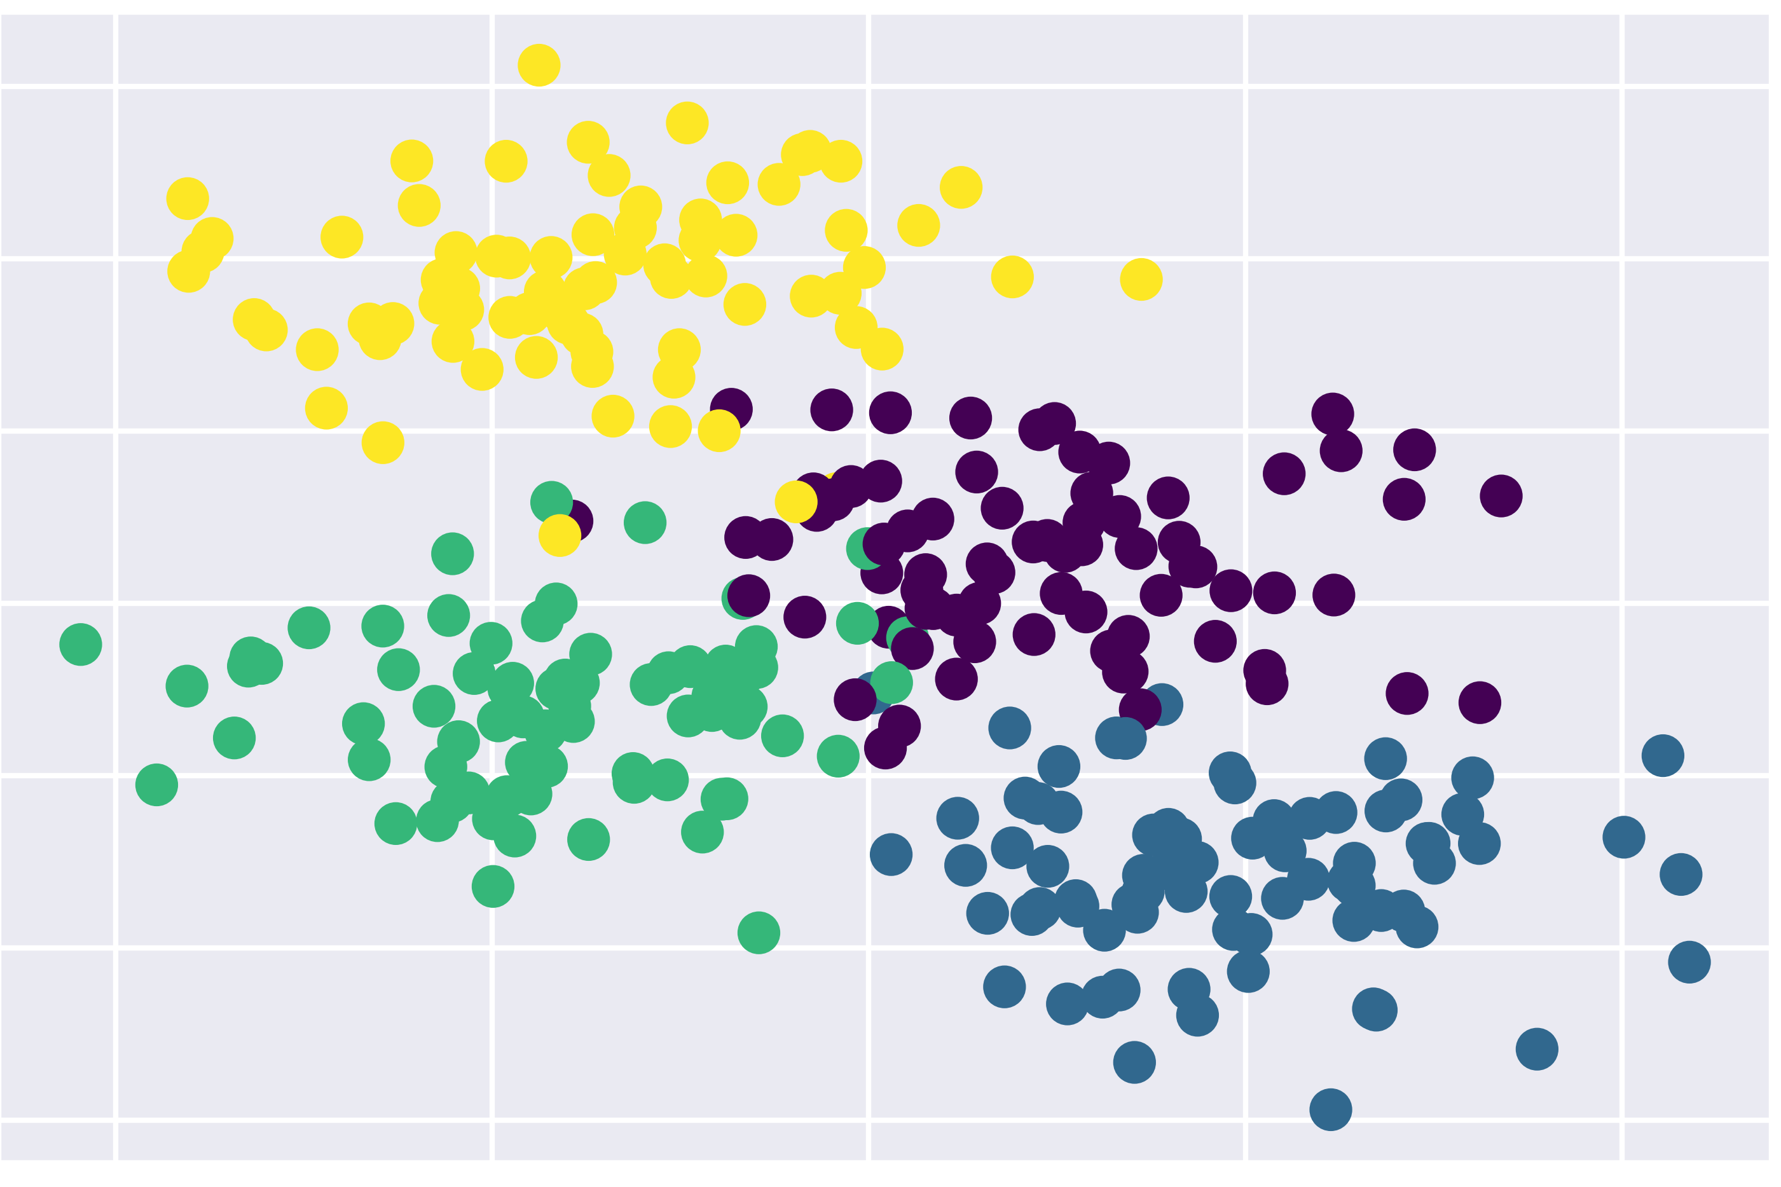
ML broad tasks
Classification
E.g., images classification, cancer detection, email spams
Regression
E.g., weather forecasting,
Clustering
Partitioning data into regions

Slide 7
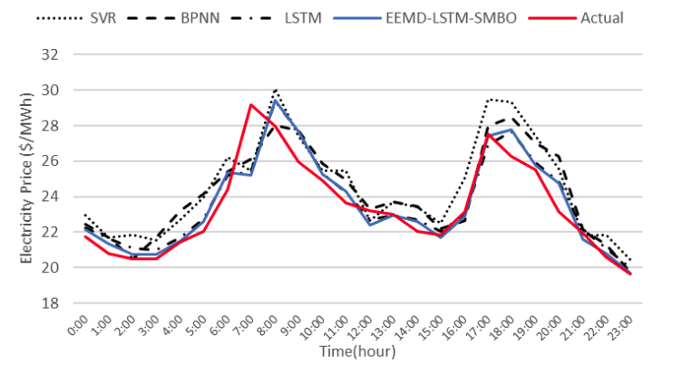
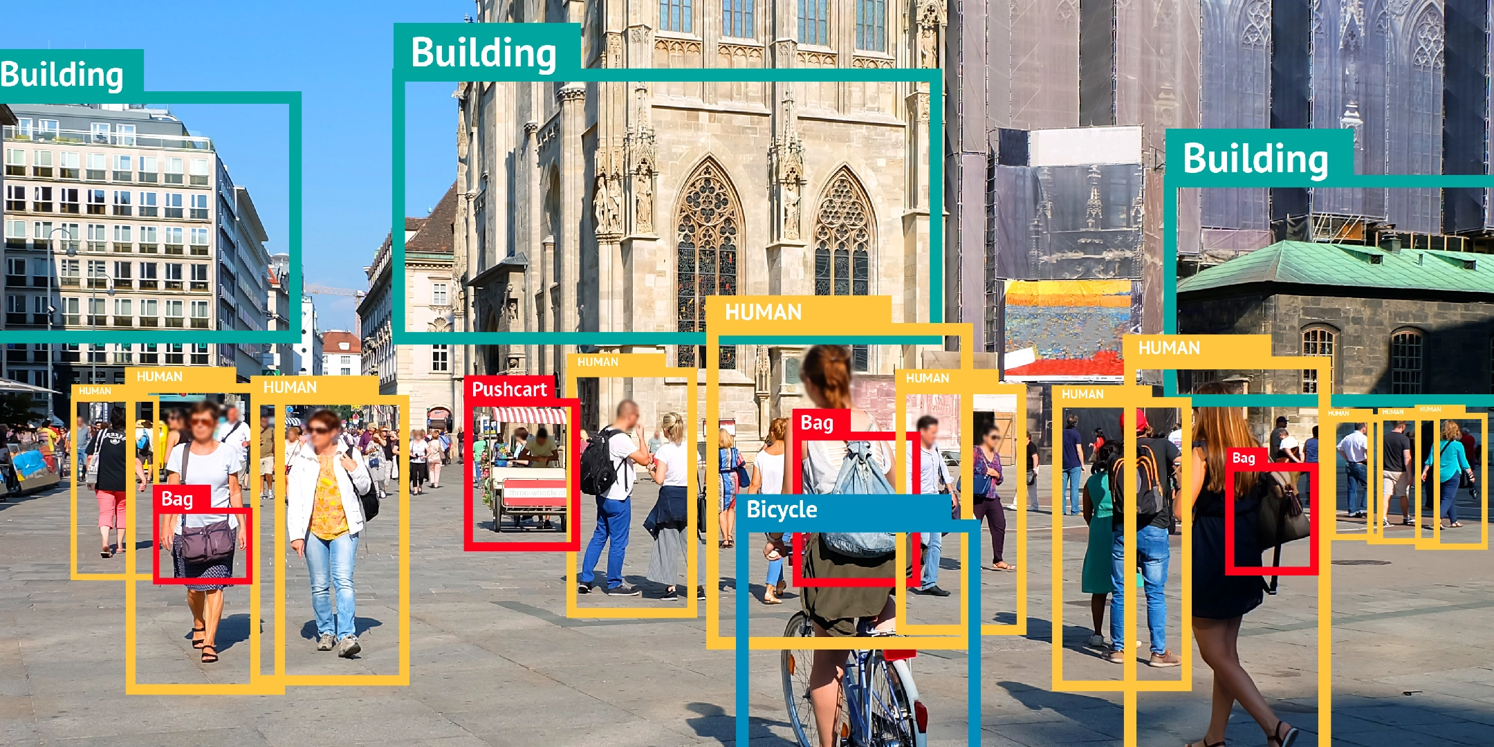
ML models
Supervised learning
We have labeled data
Classification, regression, ranking, …
Zhou et al. “An Optimized heterogeneous structure LSTM Network for Price Forecasting”, 2019.
https://bitmovin.com/object-detection/

Slide 8
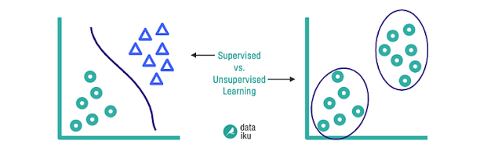
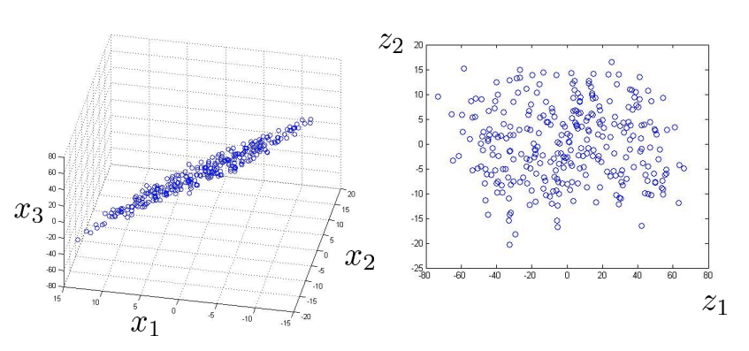
ML models
Unsupervised learning
We don’t provide labels
Clustering, dimensionality reduction
https://blog.dataiku.com/clustering-how-it-works-in-plain-english

Slide 9
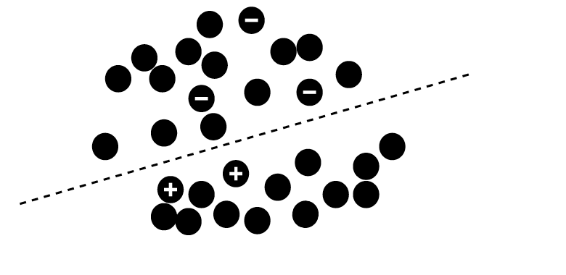
ML models
Semi-supervised learning
Only a subset of data is labeled

Slide 10
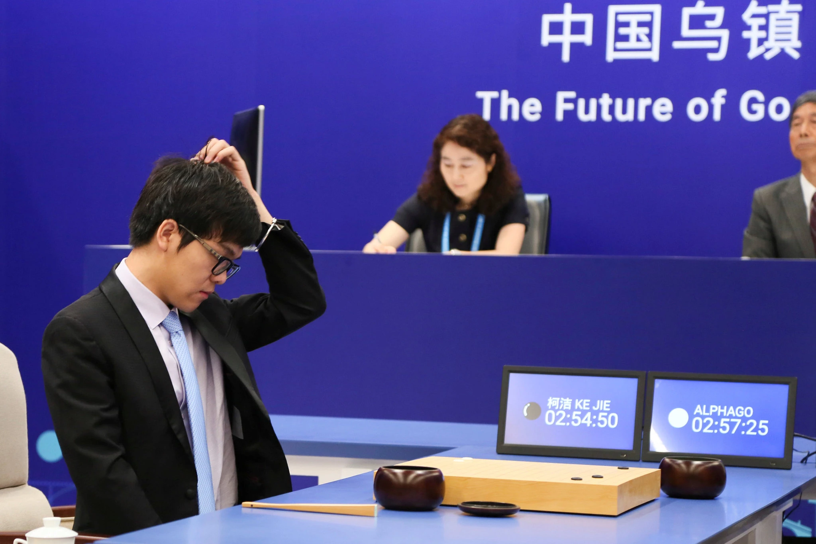
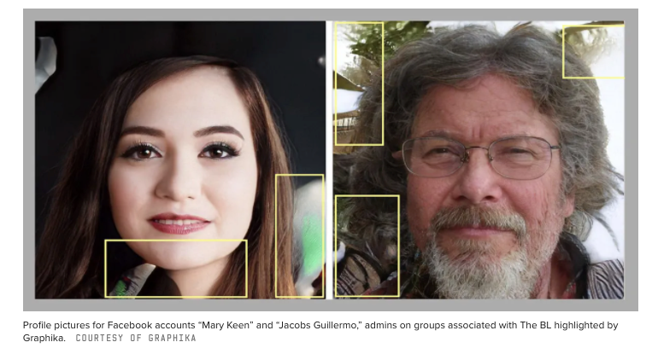
ML models
Reinforcement learning
Reward signal
Facebook Removes Accounts With AI-Generated Profile Photos
Ke Jie, the world’s top Go player, reacting during his match on Tuesday against AlphaGo, artificial intelligence software developed by a Google affiliate. Credit...China Stringer Network, via Reuters. May 23, 2017

Slide 11
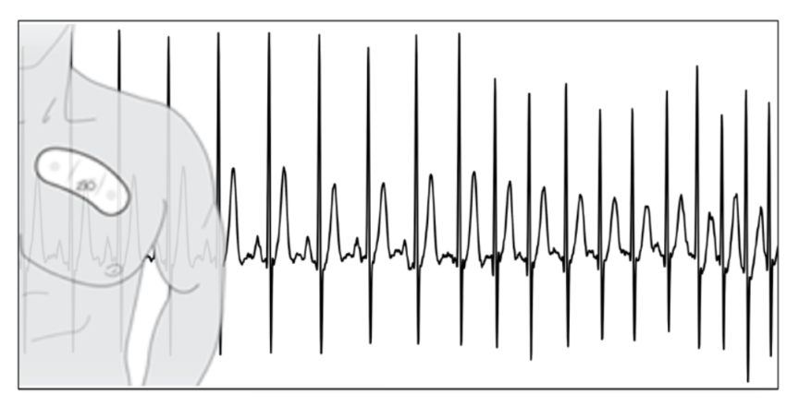
ML applications
Theoretical vs Applied ML
Importance of domain knowledge
Data preprocessing
Results interpretation
ECG data: Rajpurkar et al., 2017

Slide 12
Main ML concepts
Learning definition
How to measure learning?
Error between prediction and actual target
Adjust model parameters to decrease error
Repeat until convergence
Loss function

Slide 13
Main ML concepts
Objective definition
Data preparation
Model selection
1
Training
Evaluation
Parameters tuning
2
3
Inference
Final model

Slide 14
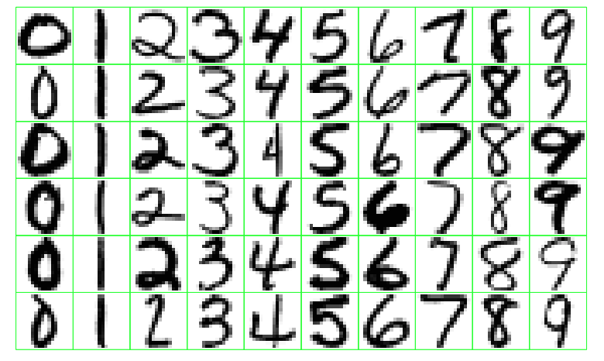
Main ML concepts
Data representation
Features
Also called predictors, inputs, independent variables
Targets
Also called labels, outputs, dependent variables
Classes
Samples

Slide 15
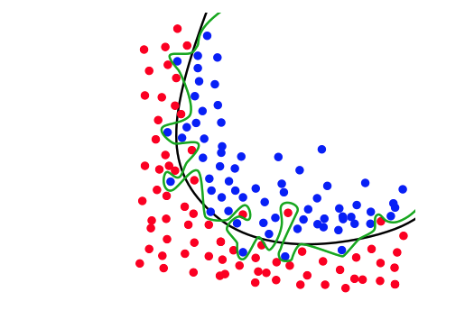
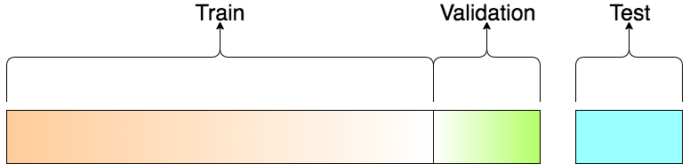
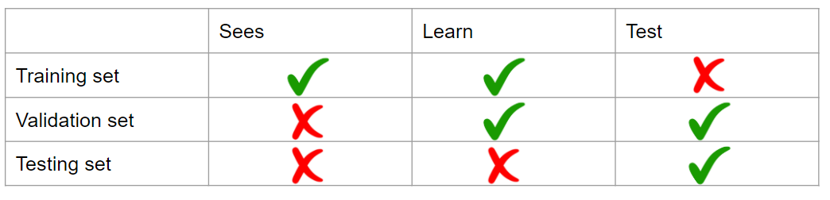
Main ML concepts
Data split into training and testing sets
Avoids overfitting
Important for generalization in the real world
Cross validation
https://elitedatascience.com/overfitting-in-machine-learning

Slide 16
Decision Trees (DTs)
Main idea: Divide space into regions using a tree structure
Classification tasks: class label
Regression tasks: real scalar
Build the DT based on the value of a single variable

Slide 17
DTs motivation
Handling of categorical variables.
Handling of missing values and unknown values.
Detection of non-linear relationships.
Visualization and interpretation in decision trees.

Slide 18
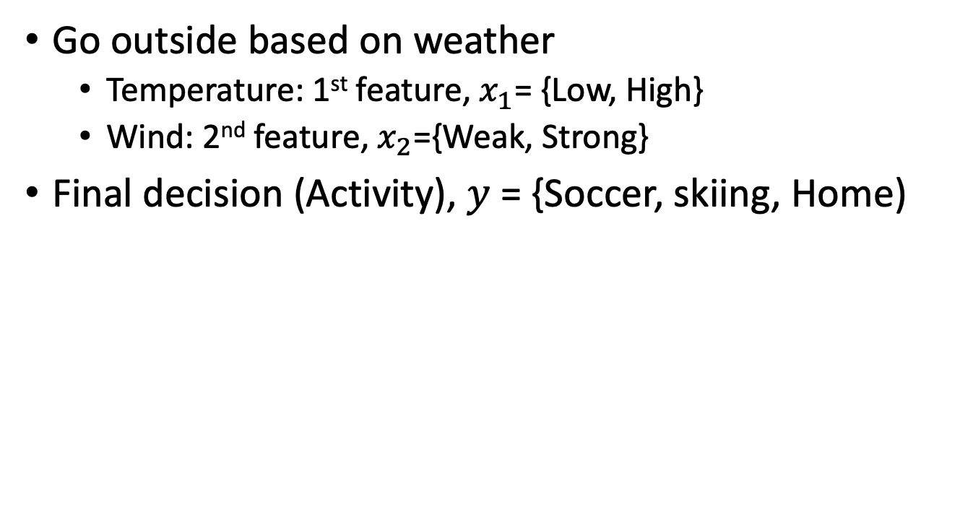
DTs main idea
Go outside based on weather
Temperature: 1st feature, $x_{1}$= {Low, High}
Wind: 2nd feature, $x_{2}$={Weak, Strong}
Final decision (Activity), $y$ = {Soccer, skiing, Home)
Low Temperature?
Strong wind?
Play soccer
Stay home
Strong wind?
Go skiing
Stay home
No
Yes

Slide 19
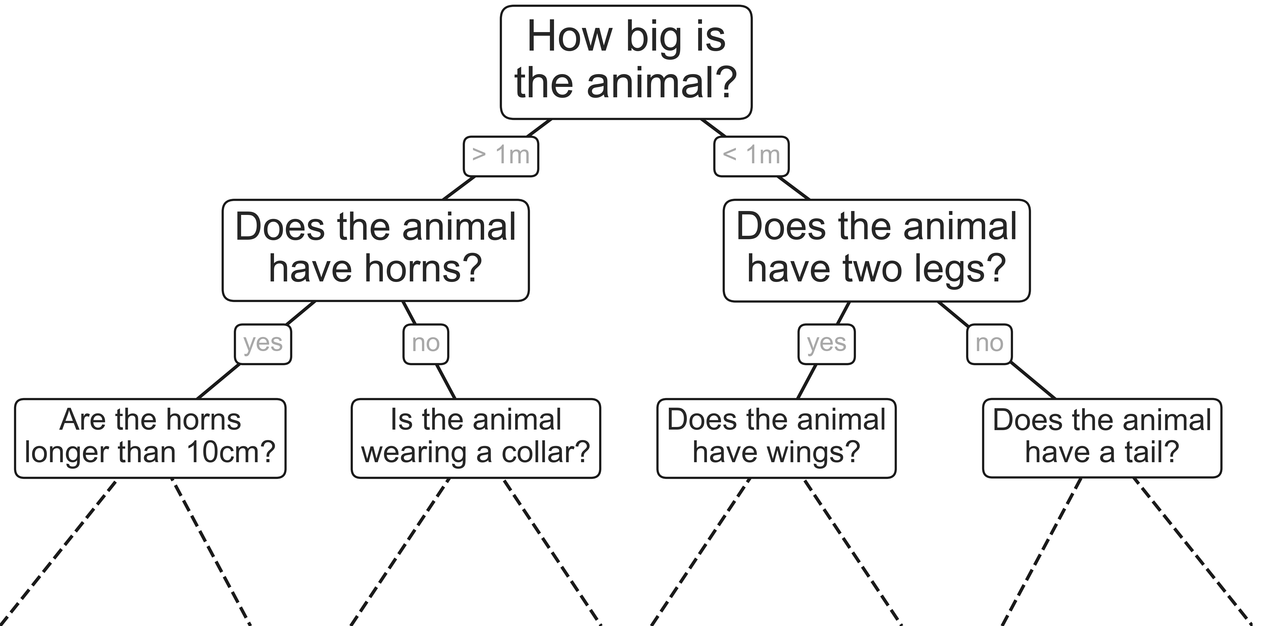
DTs main idea
Intuitive way to classify objects
Series of questions
Example: classify animals based on criteria

Slide 20
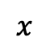
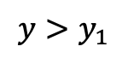
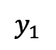
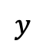
DTs example
$$y>y_{1}$$
$$y$$
$$y_{1}$$
$$x$$

Slide 21
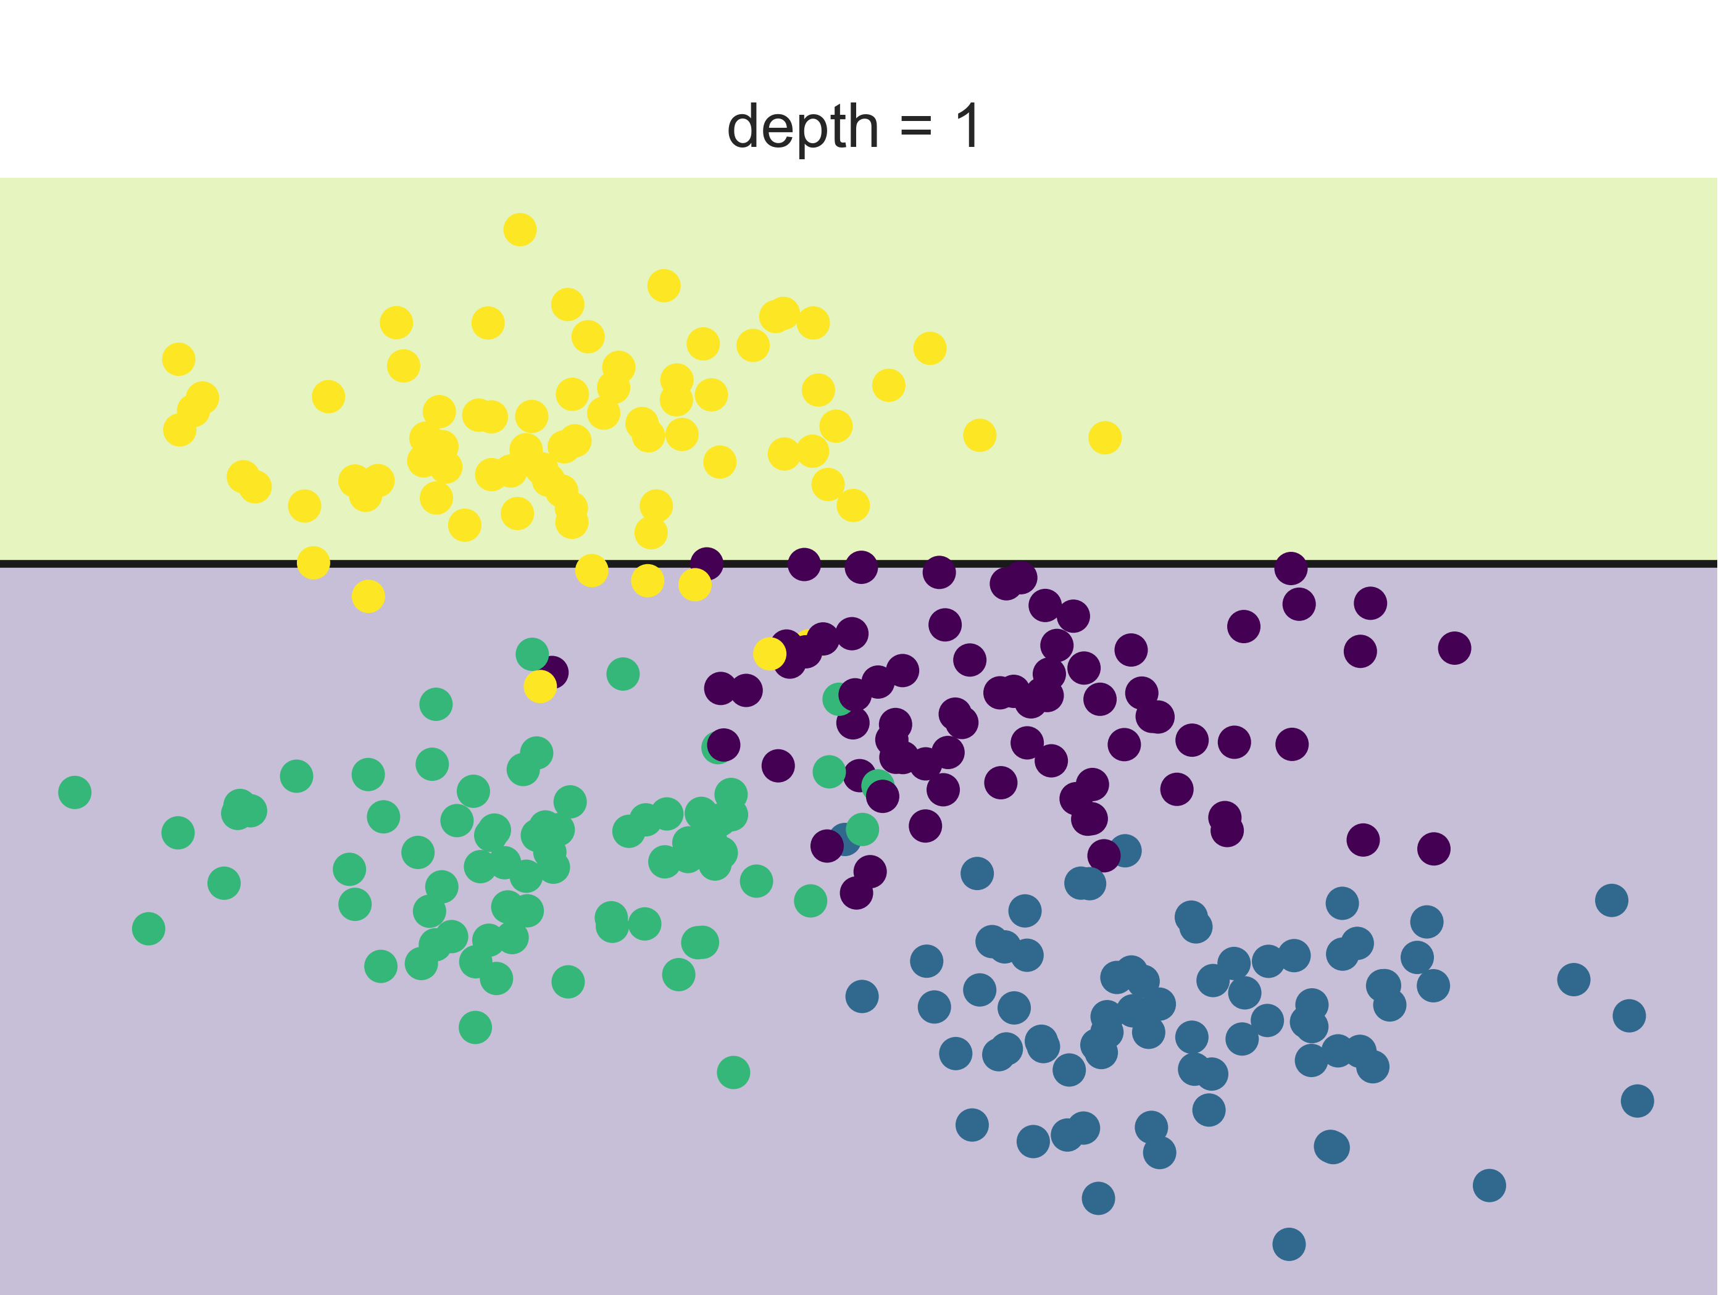
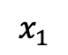
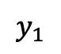
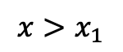
DTs example
$$y>y_{1}$$
$$x>x_{1}$$
$$y$$
yellow
$$y_{1}$$
$$x_{1}$$
$$x$$

Slide 22
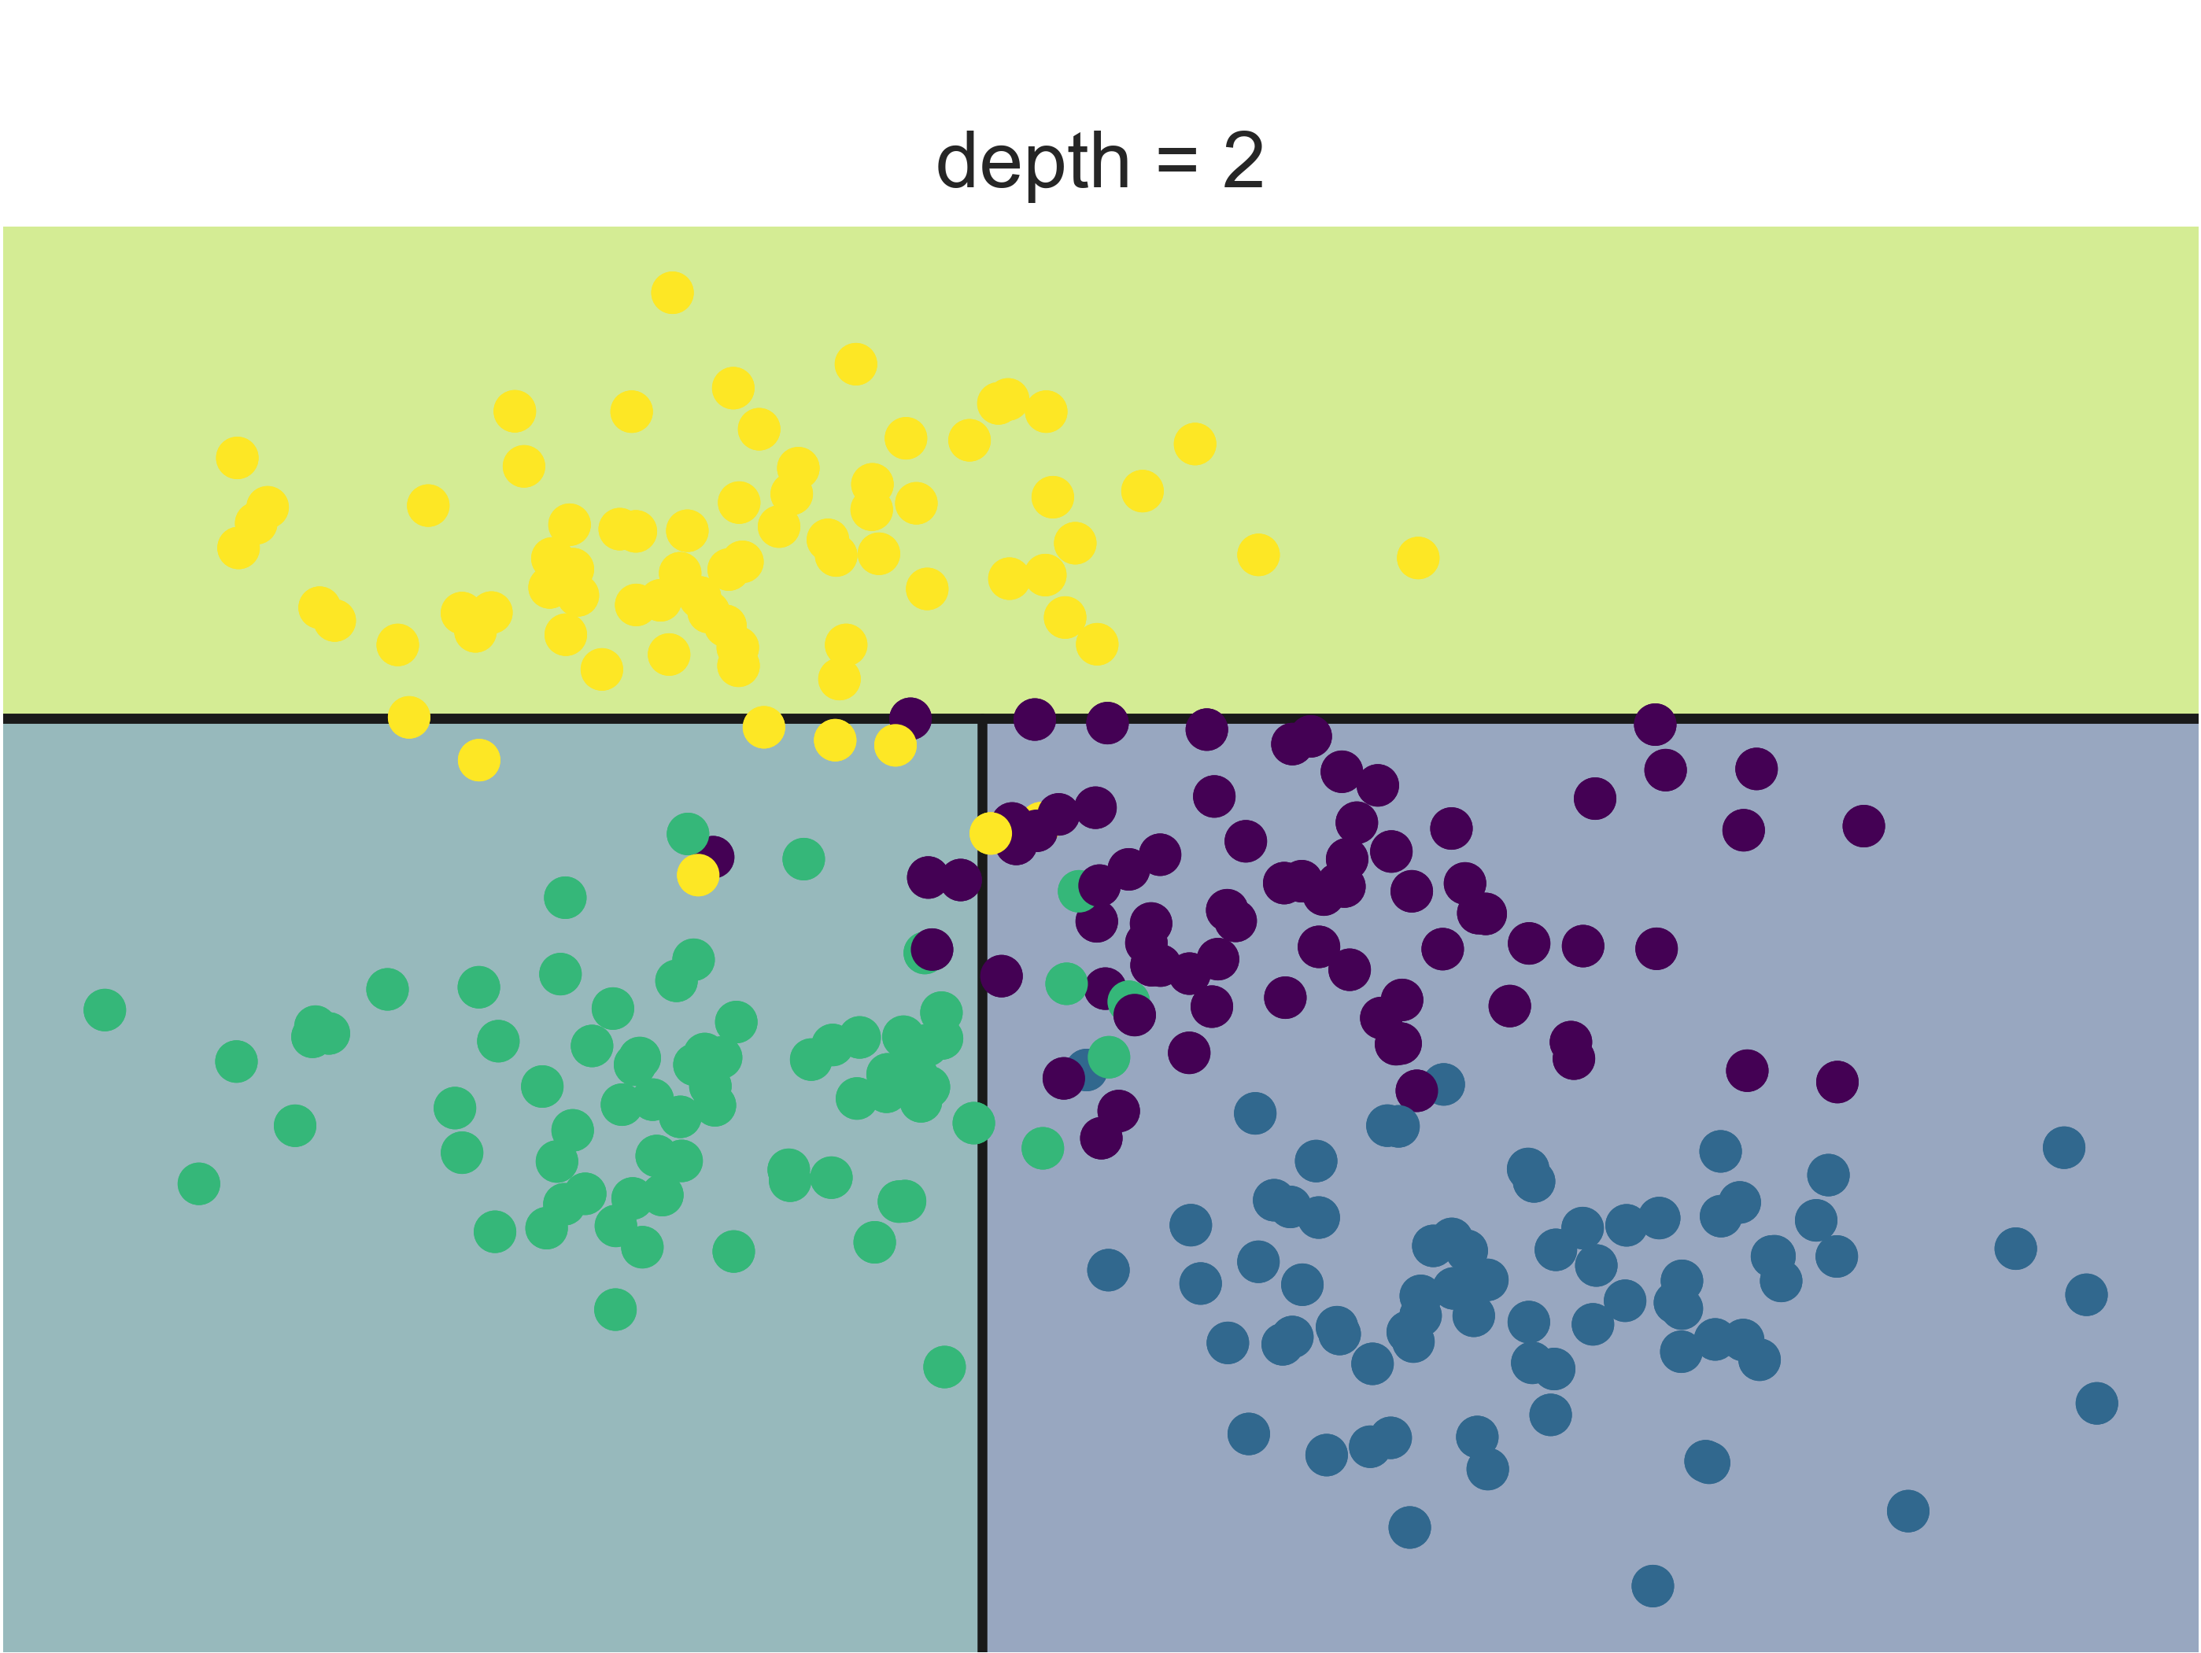
DTs example
$$y>y_{1}$$
$$x>x_{1}$$
$$y$$
yellow
$$y_{1}$$
Green
$$x_{1}$$
$$x$$

Slide 23
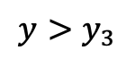
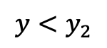
DTs example
$$y>y_{1}$$
$$x>x_{1}$$
$$y$$
yellow
$$y_{1}$$
$$y<y_{2}$$
$$y>y_{3}$$
$$x_{1}$$
$$x$$

Slide 24
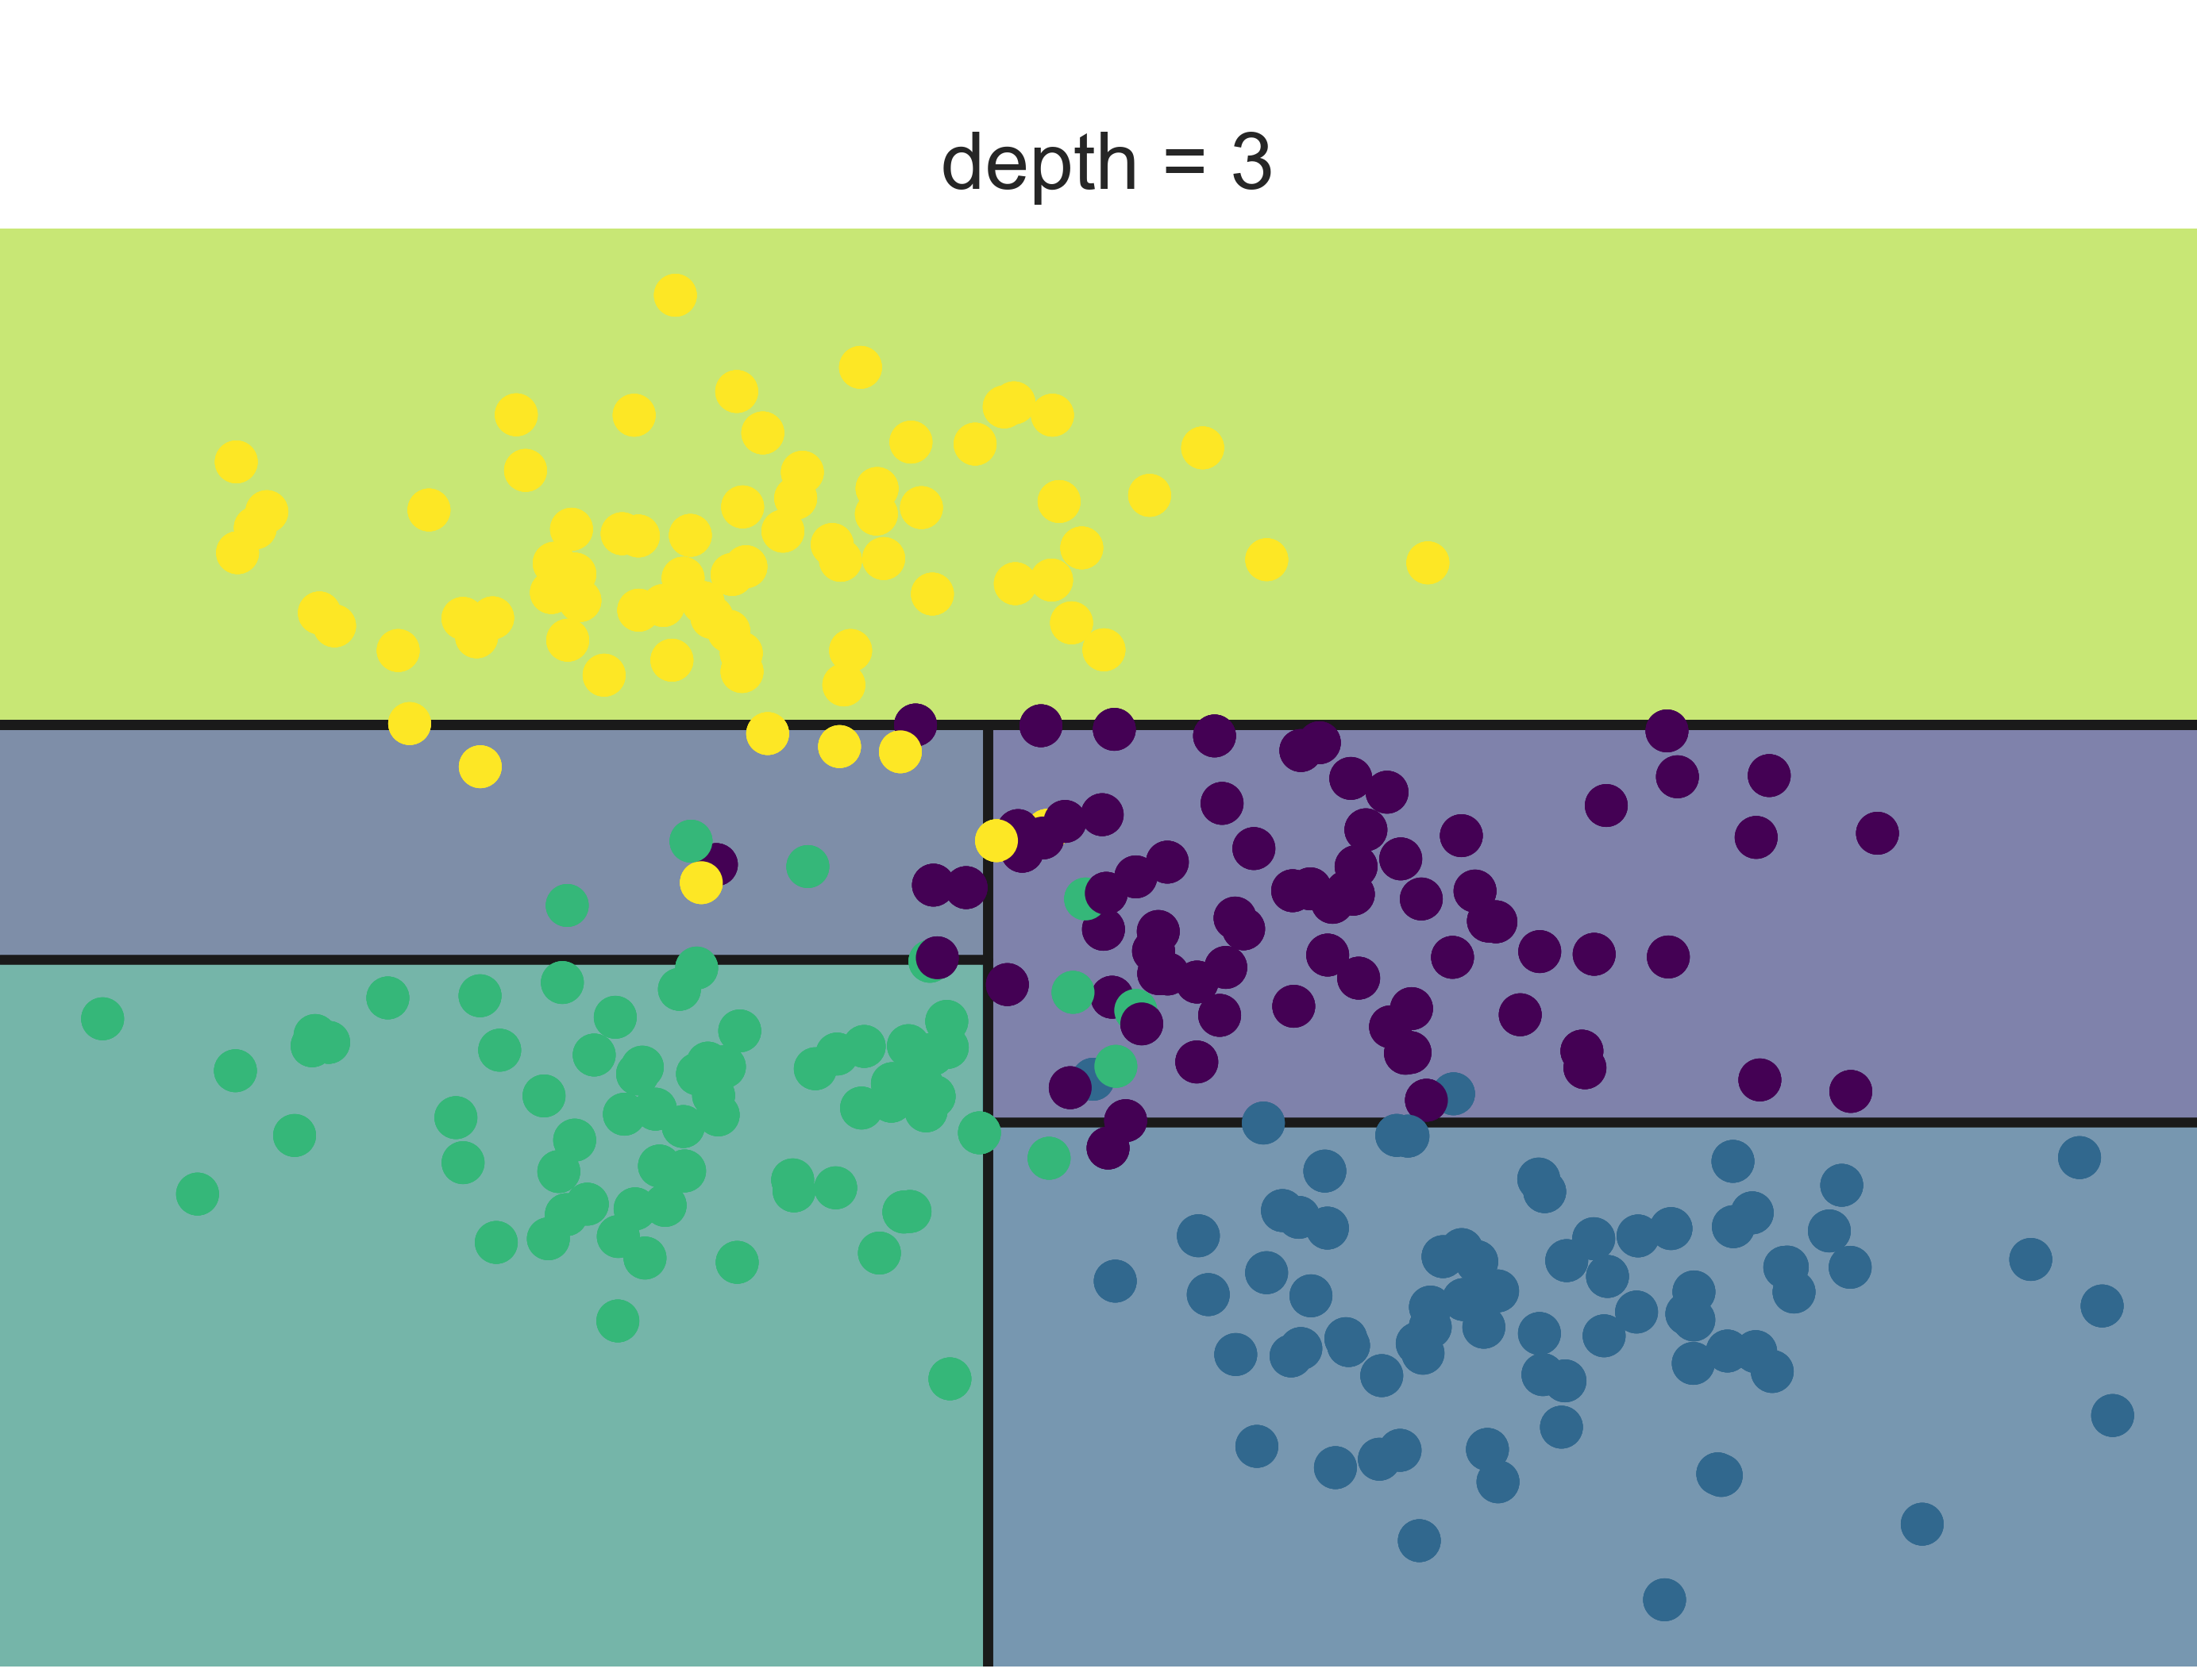
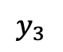
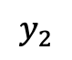
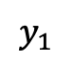
DTs example
$$y>y_{1}$$
$$x>x_{1}$$
$$y$$
yellow
$$y_{1}$$
$$y_{2}$$
$$y_{3}$$
$$y<y_{2}$$
$$y>y_{3}$$
$$x_{1}$$
$$x$$
yellow
Green
blue
purple

Slide 25
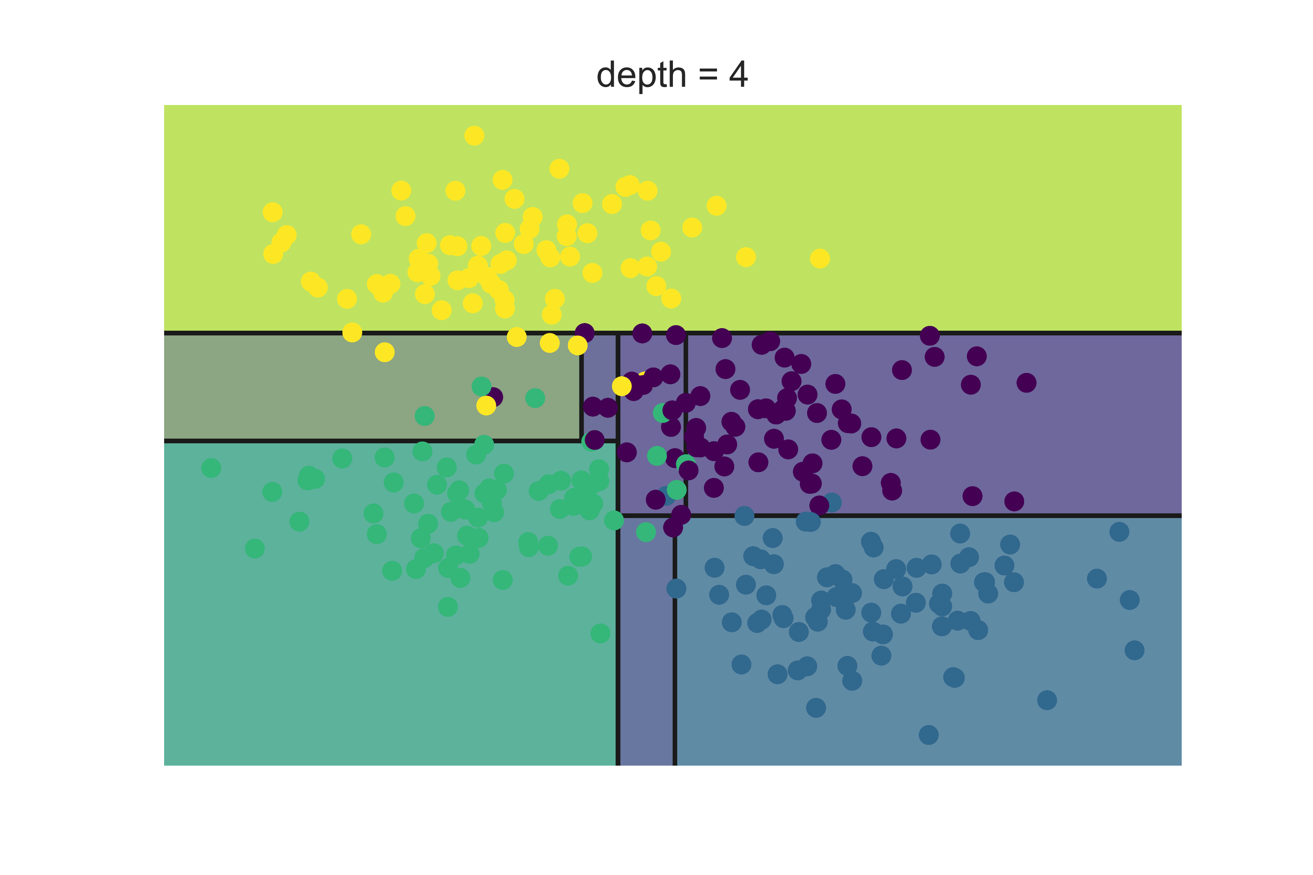
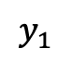
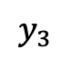
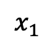
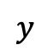
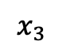
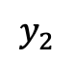
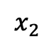
DTs example
This process can go on and on..
$$y$$
$$y_{1}$$
$$y_{2}$$
$$y_{3}$$
$$x_{3}$$
$$x_{2}$$
$$x_{1}$$
$$x$$

Slide 26
Building a DT
What is a good DT?
Cost function
How to split

Slide 27
Coding session
Link:

Slide 28
DTs example
Visual example: Home classification in San Francisco and New York

Slide 29
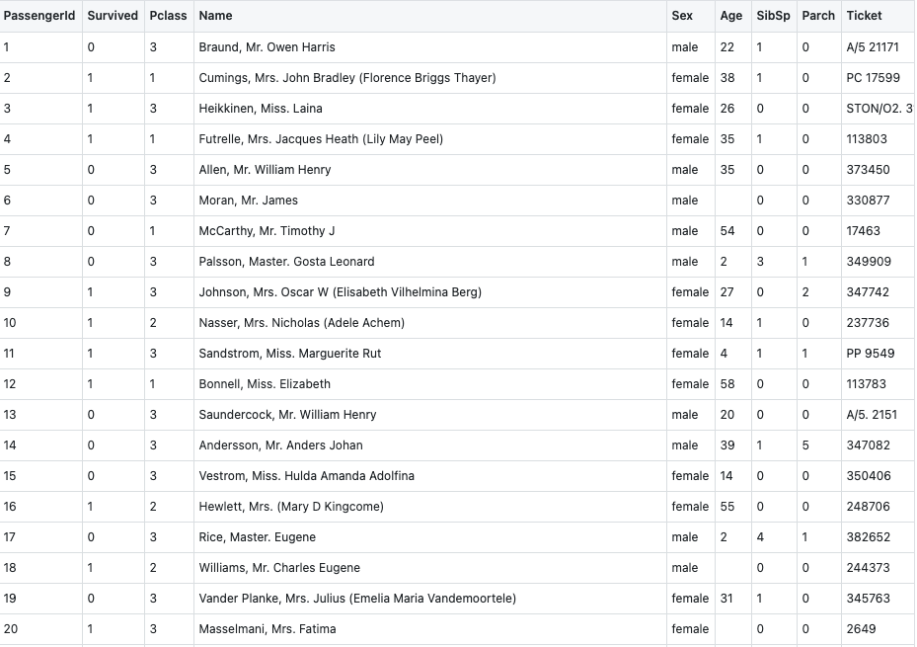
Titanic Dataset

Slide 30
Artificial Neural Networks
ANNs demo

Slide 31
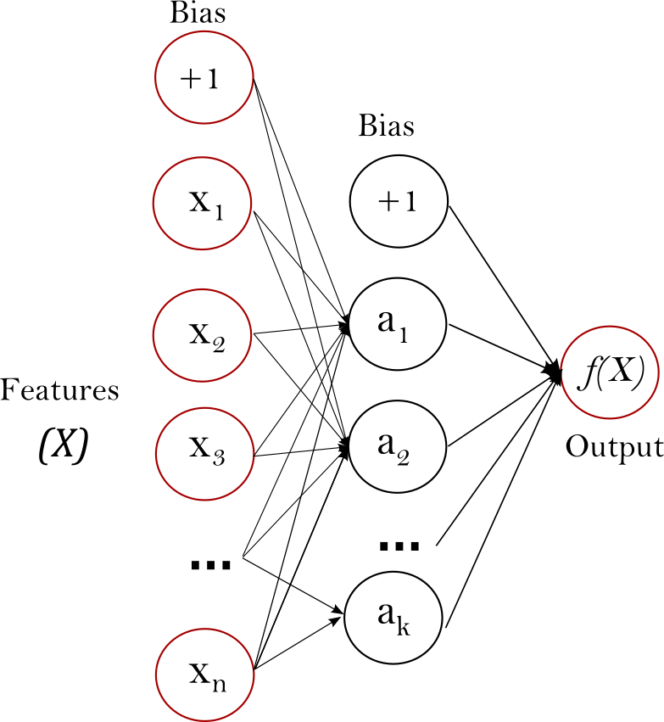
Artificial Neural Networks
https://scikit-learn.org/stable/_images/multilayerperceptron_network.png

Slide 32
Performance metrics
Accuracy is one metric
Precision, recall, and
Confusion matrix
Important for unbalanced datasets

Slide 33
Coding competition
Work on Titanic dataset
Work in groups
Compare DTs, ANNs, and SVMs
30 minutes
Go!

Slide 34
Deep Learning models
Convolutional Neural Networks

Slide 35
Deep Learning models
Recurrent Neural Networks

Slide 36
Next steps
Introductory books:
The Elements of Statistical Learning
Information Theory, Inference, and Learning Algorithms
Understanding Machine Learning: From Theory to Algorithms
Dive into Deep Learning
Online resources
Online courses: EdX, Coursera, ...
Datasets and competitions: Kaggle, IEEEDataPort, …
Online articles: Towards Data Science, Medium, …
Google is great ☺

Slide 37
References

Slide 38
Questions?

